Slide 1

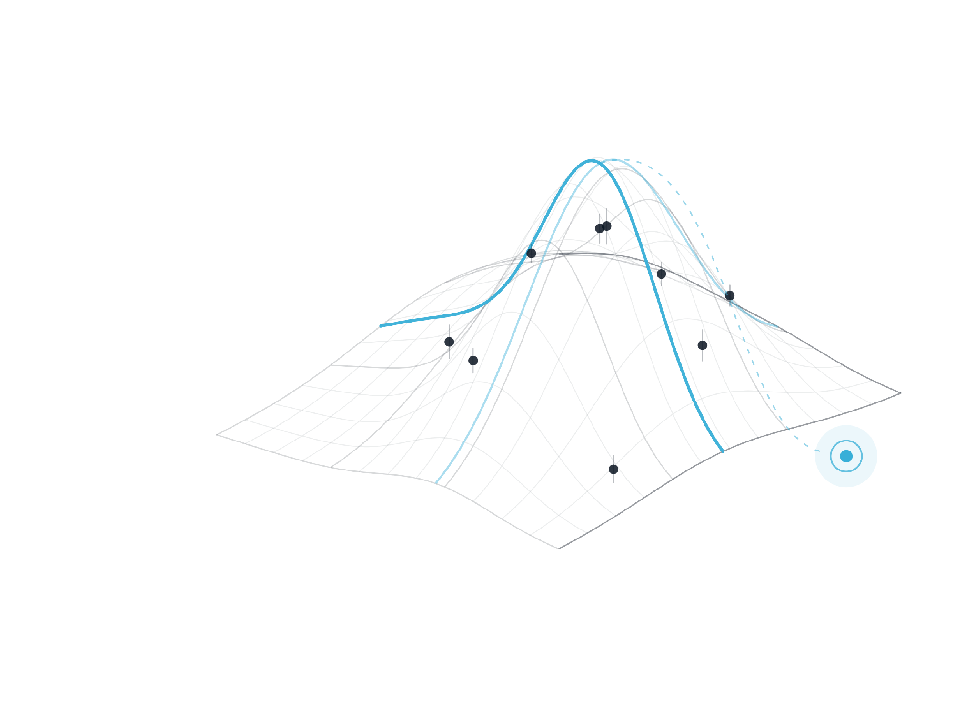
TRELLIS BY LEMNISCA
Bioprocess development, rebuilt around predictive models
Trellis is a model-centric platform for microbial fermentation and mammalian cell-culture process development — from experiment design to predictive modelling and next-best decisions.
CONFIDENTIAL
Notes:
This is not a generic AI deck. It is about one specific high-value workflow: bioprocess development. Keep the cover quiet and premium.

Slide 2
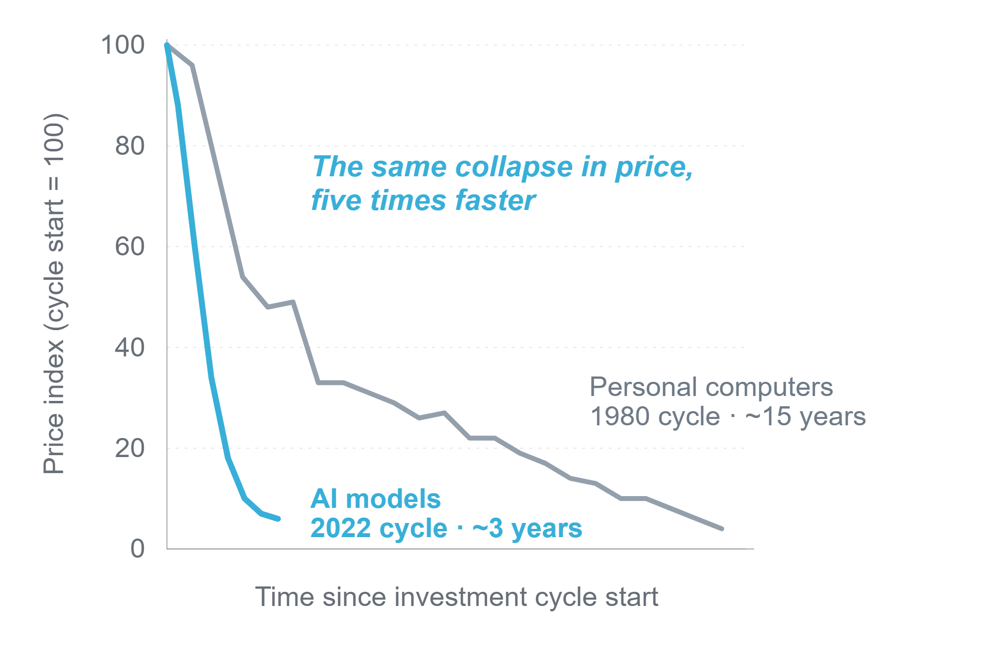
COMMODITY INTELLIGENCE
Intelligence is becoming a commodity
AI capabilities are
rising.
Their cost is
collapsing.
Access to intelligence
will not be the advantage.
Advantage will come from where — and how deeply — it is applied.
Each curve indexed to 100 at the start of its investment cycle. Sources: Goldman Sachs Global Investment Research; US Department of Commerce.
Notes:
AI is not remaining scarce — the cost curve is bending fast enough that every serious company will have access to powerful intelligence. Not a claim that AI and PCs are equivalent. Transition: if intelligence becomes widely available, access to AI will not be enough.

Slide 3

WHERE ADVANTAGE LIES
When intelligence is commoditized, advantage comes from the problem you choose — and how you apply it
AI AT THE PERIPHERY
DEPTH OF APPLICATION →
AI AT THE CORE
Assists isolated tasks
Improves consequential decisions
Produces standalone outputs
Connects the end-to-end workflow
Saves individual time
Changes learning speed and outcomes
The winners will not be defined by whether they use AI — but by which problem they use it to solve.
Notes:
The bottleneck shifts from 'Can we use AI?' to 'Do we know where and how to embed AI inside our core work?' Large companies keep assets, data, brands, facilities and regulatory depth — but headcount and legacy IT are less protective when AI-native teams coordinate expert work with fewer handoffs. Transition: this pattern has happened before.

Slide 4

In biotech, the problem worth solving with AI is the bioprocess.
OPTIMIZE
·
CHARACTERIZE
·
SCALE
·
RUN
Notes:
The answer to the previous slide. Which problem should biotech use AI to solve? The bioprocess. Full-bleed statement slide, deliberately quiet, to mark the narrative turn from the general AI thesis into bioprocess development.

Slide 5
BIOPHARMA
A promising molecule becomes a reliable medicine only if the cell culture process is reliable.
01
SITUATION
Discovery identifies a promising molecule. But patients receive it only if it is manufactured repeatedly — across batches, scales and sites.
BUSINESS IMPLICATIONS
CMC delays
Comparability burden
02
COMPLICATION
Failed tech transfers
In biologics, the manufacturing environment influences the product itself — and insufficient process understanding surfaces later.
Supply risk
Bioprocess development converts clinical promise into a reproducible, approvable and reliably supplied medicine.
Notes:
The molecule creates the therapeutic promise; the process determines whether it becomes a reliable medicine. Situation: discovery finds a molecule, but patients receive a product manufactured repeatedly across batches, scales and sites. Complication: in biologics the manufacturing environment influences the product itself and weak process understanding surfaces later as CMC delays, comparability burden, failed tech transfers and supply risk.

Slide 6
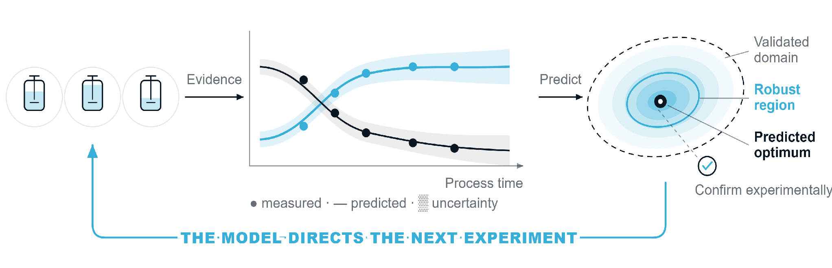
THE NEW PARADIGM
Cell culture experiments should build the model that predicts, optimizes and de-risks the bioprocess
INFORMATIVE EXPERIMENTS
PREDICTIVE PROCESS MODEL
VIRTUAL PROCESS SPACE
Each run is chosen for what it teaches the model.
Predicts process behaviour — with quantified uncertainty.
Explore untested conditions, find the robust optimum.
Every run should either reduce model uncertainty or confirm a model-based decision.
Notes:
The role of experimentation changes. Informative experiments — different feed profiles, temperature shifts, medium changes, boundary probes, replicates — are chosen because they estimate parameters, discriminate mechanisms and reveal interactions. Together with prior knowledge and existing process data they calibrate and challenge a predictive process model: mechanistic, statistical or hybrid, with quantified uncertainty. The model is then used to explore the process virtually — predicting untested conditions, locating the optimum and the robust operating region within a validated model domain, and quantifying the probability of meeting targets. The decisive point is the loop: the model directs which experiment is run next, to learn, to challenge, or to confirm. Only a mature model-based recommendation is taken to experimental confirmation at the optimum and its boundaries. Every run should either reduce decision-relevant uncertainty or confirm a model-based decision.

Slide 7
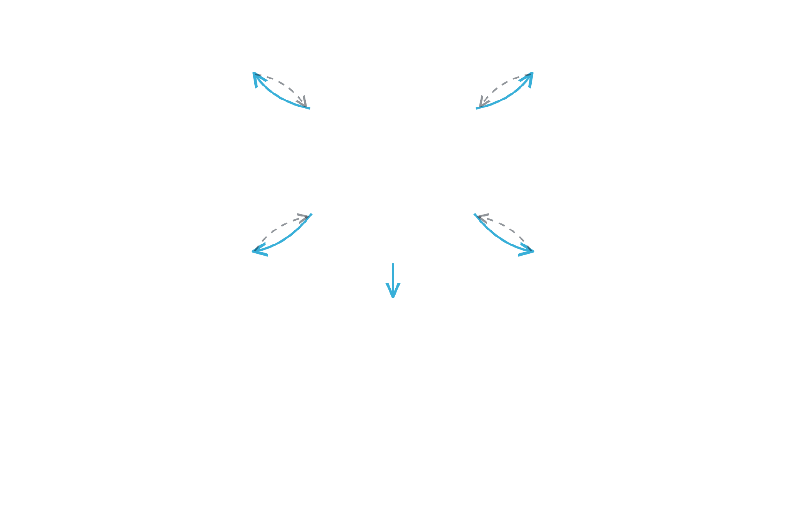





THE STRUCTURAL BARRIER
Model-centric development requires expertise that is rarely at the scientist's fingertips
Statistics & DoE
Data engineering
Statistician / DoE specialist
Data engineer
HARD TO ASSEMBLE
The full capability stack is rarely available to every development program.
BIOPROCESS SCIENTIST
Scarce specialists · Shared capacity · Competing priorities
Process modelling
ML & optimization
Bioprocess modeller
ML / optimization engineer
HARD TO USE AS ONE SYSTEM
Even when the expertise exists, it sits across separate teams, tools and workflows.
THE CONSEQUENCE
Repeated context transfer · Sequential hand-offs · Delayed feedback
The bioprocess scientist becomes the manual integration layer.
They repeatedly transfer context, coordinate analyses and reconcile disconnected outputs.
Every exchange is manual — experimental design · raw data · model assumptions · analysis output
Notes:
Model-centric development needs a complete multidisciplinary capability stack. First barrier: it is hard to assemble — the specialists are scarce, shared across programs and pulled by competing priorities. Second barrier: even where the expertise exists, it is hard to use as one system. On the right, every specialist interaction passes through the scientist: context goes out, disconnected output comes back, and nothing connects specialist to specialist. The consequence: the bioprocess scientist becomes the manual integration layer — repeatedly transferring context, coordinating analyses and reconciling disconnected outputs.

Slide 8
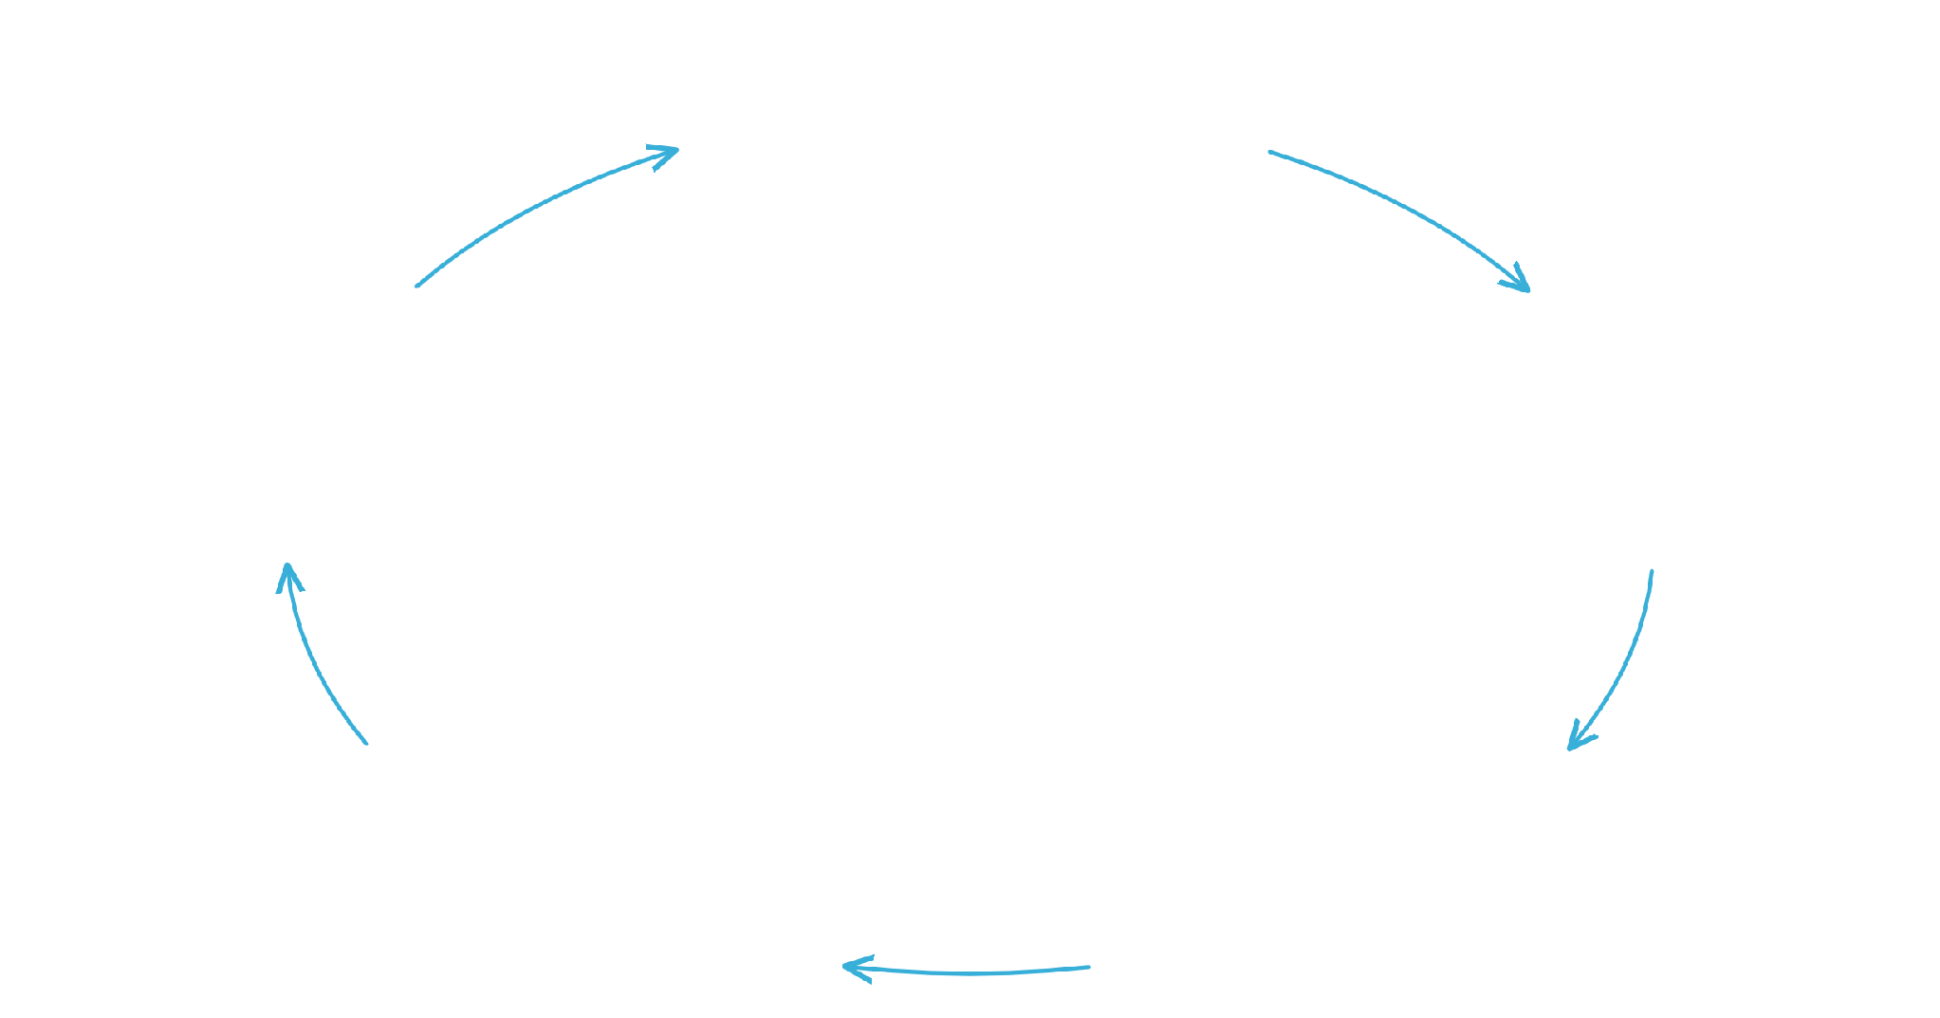

THE TRELLIS RESOLUTION
Trellis keeps the scientist in control while specialist agents execute the development loop
DOE AGENT
Design experiments
OPTIMIZATION AGENT
PROTOCOL AGENT
AI orchestrates the workflow.
Optimize & select next experiment
Generate protocols
Scientific tools perform the work.
The scientist remains in control.
BIOPROCESS SCIENTIST
defines · reviews · decides
BIOPROCESS MODELLING AGENT
DATA ENGINEERING AGENT
Build models
Structure the data
ONE SHARED, VERSIONED PROCESS CONTEXT
Experimental design
Protocols
Raw & processed data
Model assumptions
Results
Uncertainty
Decisions
Notes:
That is why we built Trellis. On the left are the five specialist agents Trellis brings into the workflow — DoE and statistics, protocols, data engineering, modelling, and ML and optimization — each doing real scientific work. On the right, those same capabilities run as one closed loop with the bioprocess scientist firmly at the centre: the scientist defines objectives, reviews the evidence and makes the decisions, while the agents support each stage. All of them operate on one shared, continuously evolving representation of the process. AI orchestrates the workflow; validated tools do the scientific work; the scientist remains in control.

Slide 9
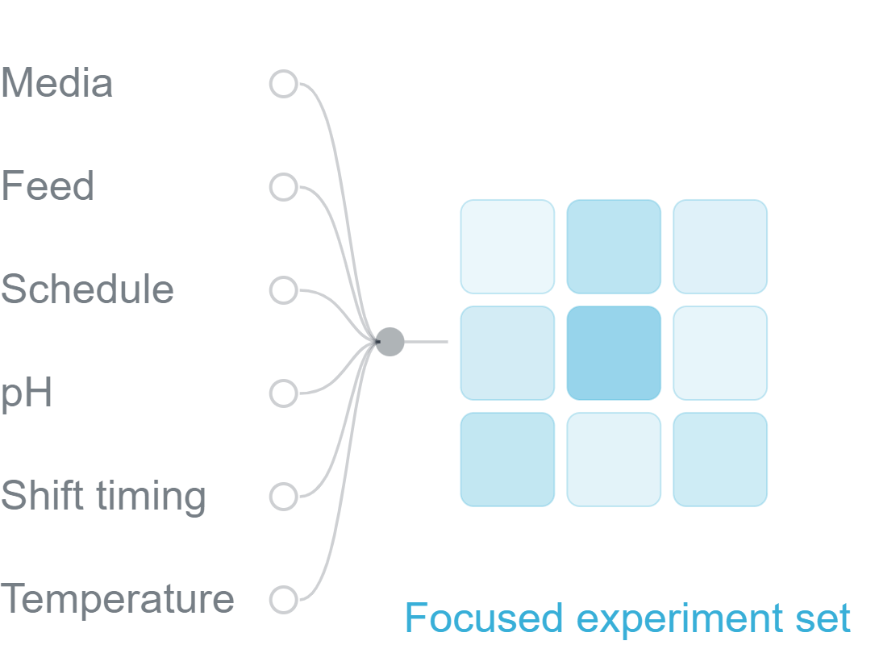
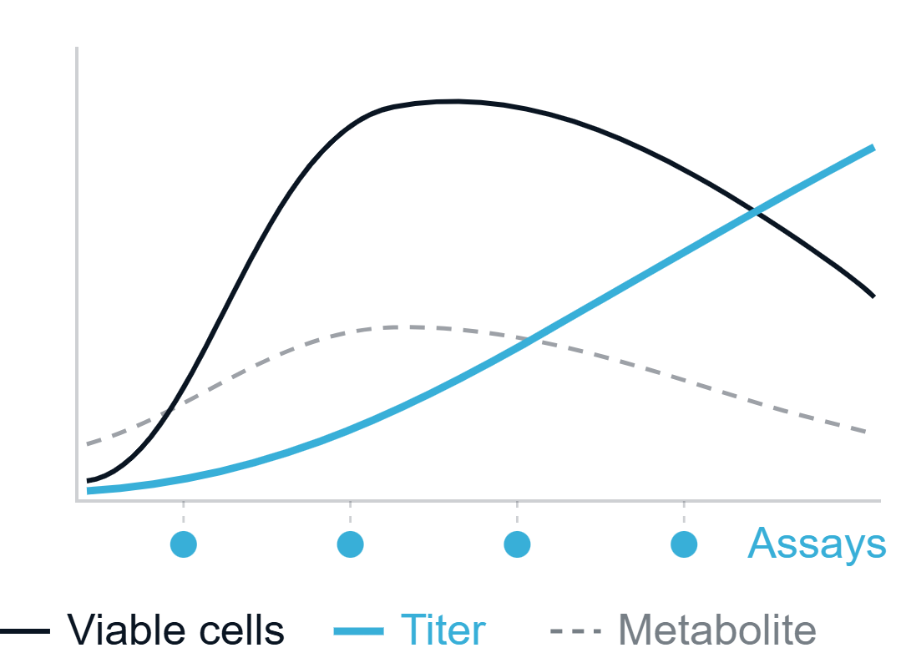
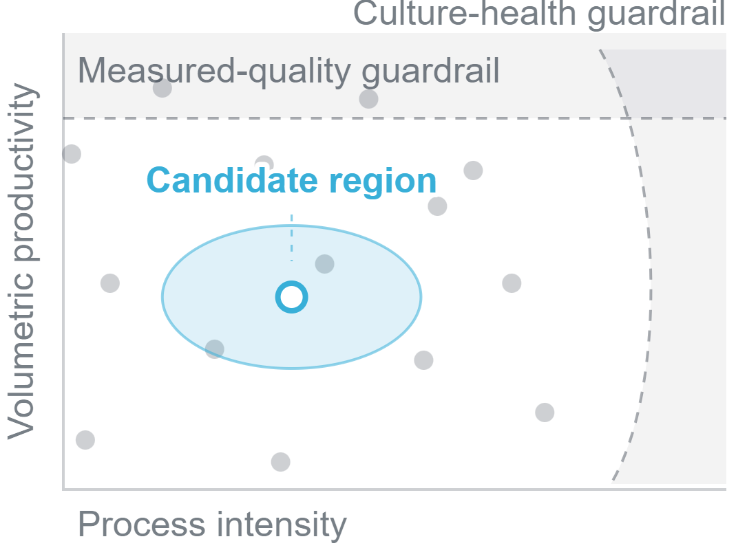
USE CASE · BIOPHARMA
Trellis guides successive experiments toward a higher-productivity CHO process — within culture-health and measured-quality guardrails.
1
DESIGN THE JOINT SEARCH
2
LEARN CULTURE BEHAVIOUR
3
OPTIMIZE AND CONFIRM
Explore media, feed, schedule, pH strategy, temperature-shift timing and setpoint together.
Link interventions to cell, metabolite and titer trajectories — and to measured quality responses.
Recommend a candidate strategy; test productivity, culture health, quality responses and repeatability.
SCIENTIST DEFINES THE OBJECTIVE
TRELLIS RUNS THE LEARNING CYCLE
SCIENTIST APPROVES THE NEXT EXPERIMENT
→
→
DoE · Protocols · Data · Models · Simulation · Optimization
Illustrative — not customer results.
Notes:
A biopharma use case at L1. A repeatable CHO process exists, but interacting media, feed and operating choices limit performance. Three scientific decisions: design one joint search across media, feed, schedule, pH and the temperature shift; learn how interventions move cell, metabolite and titer behaviour and the measured quality responses; then recommend and confirm a candidate. Underneath, the scientist sets the objective and constraints, Trellis agents run the learning cycle, and the scientist approves the next experiment. Volumetric productivity is the single objective; culture health and measured quality are guardrails. All plots are illustrative, not results.

Slide 10
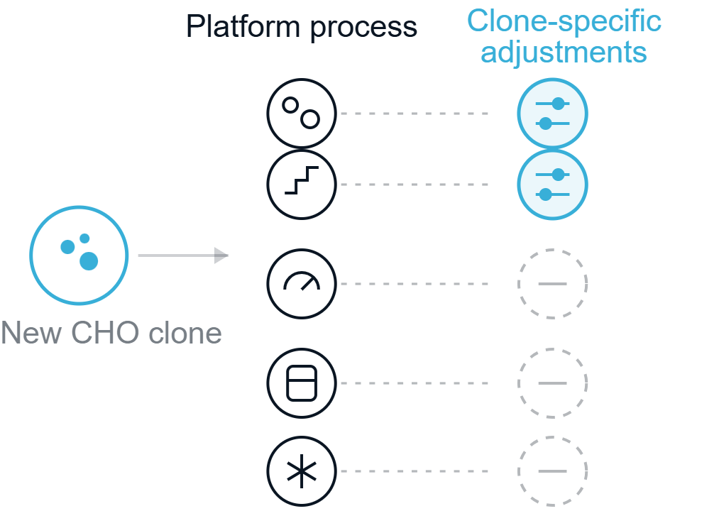
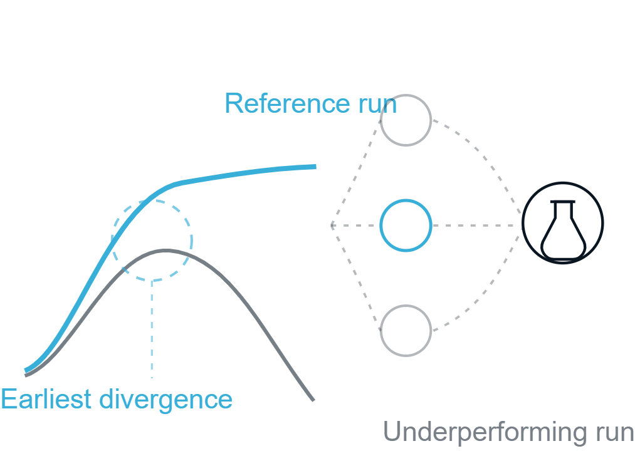
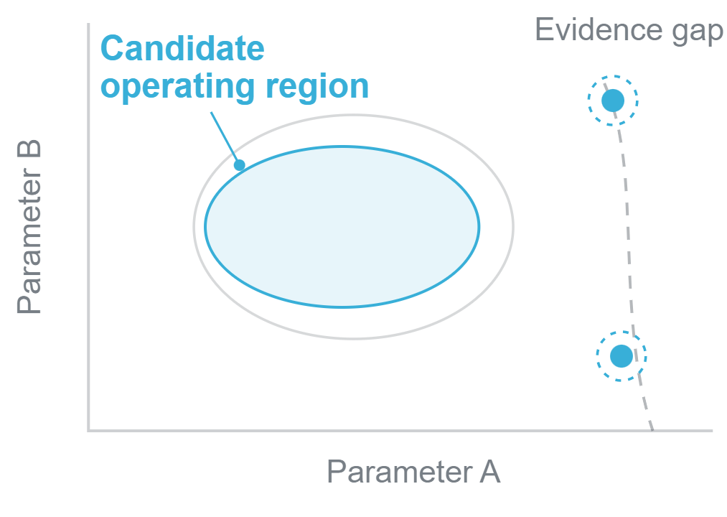
BIOPHARMA · MORE USE CASES
Trellis also helps teams adapt, recover and de-risk CHO processes.
ADAPT
RECOVER
DE-RISK
Adapt a platform to a new clone
Recover low or variable performance
Define a candidate operating window
Determine what can remain fixed — and which clone-specific changes require evidence.
Rank and test hypotheses for low titer, early viability loss or run-to-run variability.
Identify supported ranges, important interactions and evidence gaps before formal process characterization.
ACROSS ALL THREE, TRELLIS AGENTS ORCHESTRATE THE SAME SCIENTIST-APPROVED, MODEL-GUIDED LEARNING LOOP.
Illustrative applications — not customer results.
Notes:
Where else Trellis creates value in CHO upstream development, beyond the media and feed example. Three recurring decisions: adapt a platform process to a new production clone, recover low or variable performance through ranked and tested hypotheses, and define a candidate operating window before formal process characterization. Quality is treated as measured responses, never continuous trajectories, and nothing here implies a validated range or a regulatory design space.

Slide 11
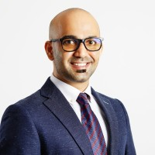
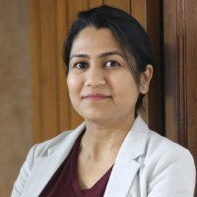
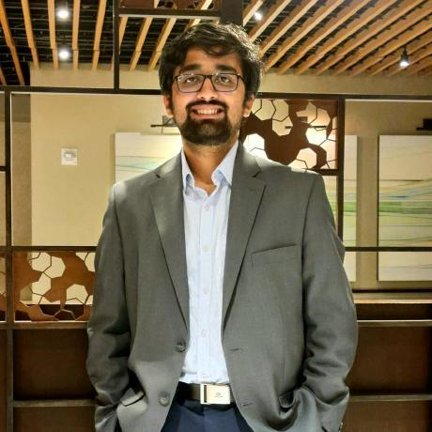
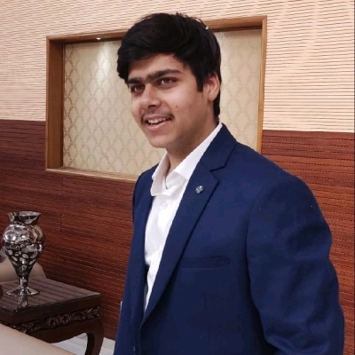










TEAM
Your scientists will work directly with the multidisciplinary team building Trellis
We combine bioprocess science, computational modelling, AI and software engineering across the complete development workflow.
LEADERSHIP
Dr. Pushkar Pendse
Dr. Shilpa Nargund
CEO
CTO
Bioprocess strategy · Process engineering · Pharmaceutical manufacturing
Bioprocess modelling & digital twins · Scientific product development
TECHNICAL TEAM
Dr. Gaurav Deshmukh
Anmol Goel
Nikhil Bhamwani
Computational Engineering
Bioprocess Systems Engineering
Software Engineering
Mechanistic & hybrid modelling · ML · Scientific computing
Experimental design · Protocols · Bioprocess workflows
Product engineering · Data infrastructure · Systems integration
SELECTED EXPERIENCE ACROSS INDUSTRY AND ACADEMIA
IIT Delhi
ICT Mumbai
Notes:
This slide is about partnership and delivery credibility, not biography. The takeaway: the customer's scientists work directly with a multidisciplinary team that understands bioprocess science, modelling, AI, data and software. Two leadership profiles, three technical profiles. The logo line is proof of relevant experience, not an endorsement.

Slide 12
PAID PILOT
Start with one process and one objective — prove the value in a focused paid pilot
01
02
8–12 WEEKS
03
Select process & objective
Run a focused Trellis pilot
Decide whether to expand
One fermentation or cell-culture process, one clearly defined objective, one development team.
Trellis configured to the real workflow, against KPIs agreed before kickoff.
Final readout with measured impact and a next-step roadmap toward broader deployment.
PARTNERSHIP INPUTS AND PROTECTIONS
COMMERCIAL SHAPE
You provide
You keep
How we protect it
Fixed fee
Data, team time and materials for one process.
Your data, models, workflows and findings.
Process IP stays yours; we learn only within agreed confidentiality boundaries.
Defined scope
Agreed before kickoff, with no open-ended commitment.
One process. One high-value objective. One controlled paid pilot.
Notes:
Do not ask the customer to transform all process development at once — start with one important problem and prove measurable value. Duration 8–12 weeks depending on data and scope. Recommended design-partner fee (keep OUT of the deck if early): India INR 15–30 lakh; international USD 25k–60k. Deliverables: configured Trellis workflow, structured dataset, DOE/protocol/analysis workflow, predictive model with uncertainty, next-experiment recommendations, final readout with measured impact and roadmap.

Slide 13
PILOT KPIS
A pilot should prove faster learning, better models and stronger process decisions
KPI
WHAT WE MEASURE
BASELINE AT KICKOFF
PILOT READOUT
OUTCOME AND SPEED
Process outcome
Improvement toward the agreed objective
Agreed reference run
Measured change
Analysis cycle time
Experiment completion to interpreted result
Current turnaround
Timed in pilot
Experimental efficiency
Runs required to reach the objective
Historic rounds
Rounds used
MODEL AND UNDERSTANDING
Model quality
Predictive accuracy and uncertainty calibration
No model
Validated model
Process understanding
Critical parameters and interactions identified
Partly tacit
Documented
ROBUSTNESS AND REPRODUCIBILITY
Robustness confidence
Operating region and disturbance sensitivity
Region undefined
Candidate window
Workflow reproducibility
Analysis, assumptions and decision history
Manual hand-offs
Versioned context
BUSINESS VALUE
Shorter decision cycles
Fewer low-information experiments
Greater confidence before scale-up
Knowledge preserved across teams
Notes:
Judge the pilot on measurable operational and scientific outcomes, not AI novelty. The baseline and readout columns describe how each KPI is established — no numerical claims are made before kickoff. Business value: shorter decision cycles, fewer low-information experiments, greater confidence before scale-up, knowledge preserved across teams.

Slide 14
THE ASK
Start with one process, one objective and one focused paid pilot.
Configure Trellis around a real development workflow, measure the impact, and decide whether to expand.
ONE PROCESS
ONE HIGH-VALUE OBJECTIVE
8–12 WEEK PAID PILOT
Select the first process-development problem.
Notes:
Close on the commercial ask. One process, one high-value objective, one 8–12 week paid pilot. Ask the room to name the first process-development problem before the meeting ends.

